Slide 1
Individual heterogeneity, non-random mixing and networks
Nicholas Grassly

Slide 2
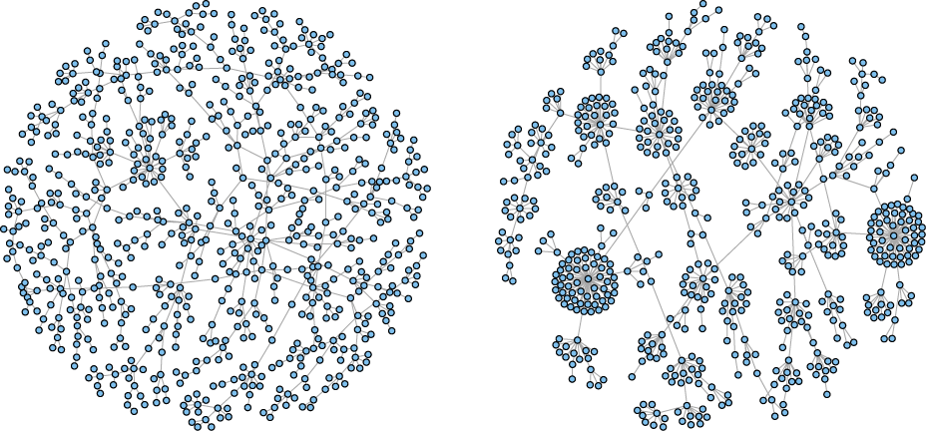
Heterogeneity in disease transmission
Transmission trees

Slide 3
Lecture outline
Key concepts for heterogeneity in disease transmission
Emergent epidemic dynamics
Modelling approaches to heterogeneity and non-random mixing
Contact networks

Slide 4
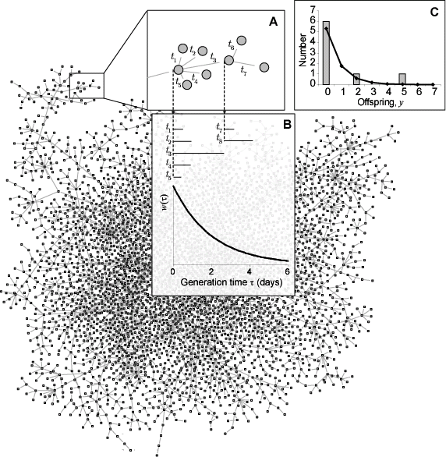
A large transmission tree

Slide 5
Definitions
If Y is the number of secondary infections generated by a single infected individual, then the probability function describing the distribution of Y is referred to as the offspring distribution
If t is the time elapsed between one person being infected and infecting someone else, then the probability distribution of these times is the generation time distribution, denoted w(t)

Slide 6
Factors determining the offspring and generation time distributions
Infectiousness over time since exposure β(τ)
Contact patterns
Susceptibility of contacts and process of transmission

Slide 7
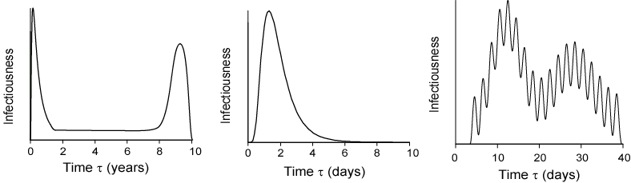
Typical infectiousness over time since infection for three major pathogens

Slide 8
The reproductive number in a randomly mixing population
Formally, the probability that an infected person will infect another person during a small time-interval between τ and τ +δt is
, where s is the probability that the other person is susceptible to infection.
Summing up or integrating infectiousness over the time since infection gives the expected number of offspring,
In a randomly mixing population averaging this quantity over all individuals gives the reproduction number R
In a naïve entirely susceptible population (s=1) this is called the basic reproduction number R₀

Slide 9
Variation in infectiousness
Infectiousness typically varies among infected individuals (e.g. because of host-pathogen genetics, behaviour of the host, )
The offspring and generation time distributions can be derived as a function of the variation in β(τ)
For example, in the SIR model infected individuals are all equally infectious but the duration of infectiousness (and generation time) is exponentially distributed. This leads to a geometric offspring distribution.

Slide 10
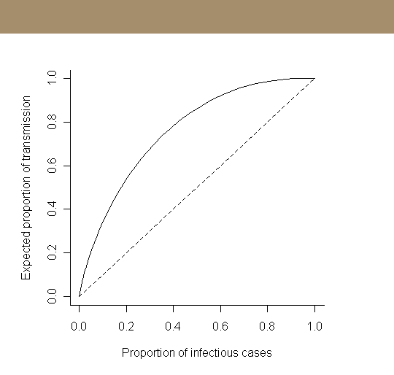
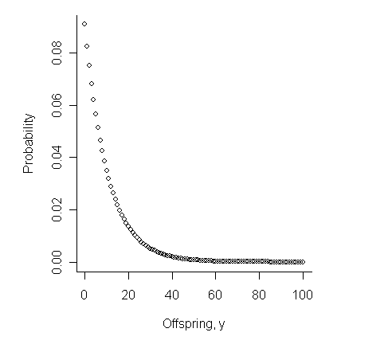
SIR model offspring distribution
homogeneous population

Slide 11
Observed offspring distributions
heterogeneity is the result of many different factors, not just variation in the duration of infection!
From Lloyd-Smith et al. 2005

Slide 12
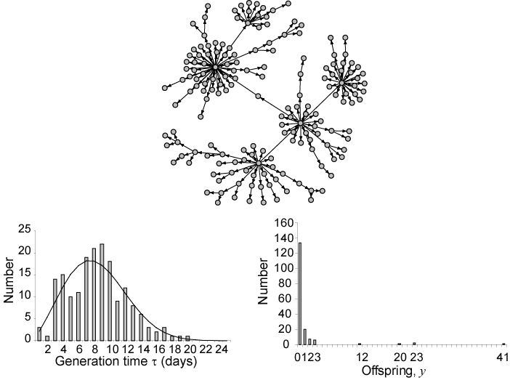
Estimating the offspring and generation time distributions
SARS – Singapore 2003

Slide 13
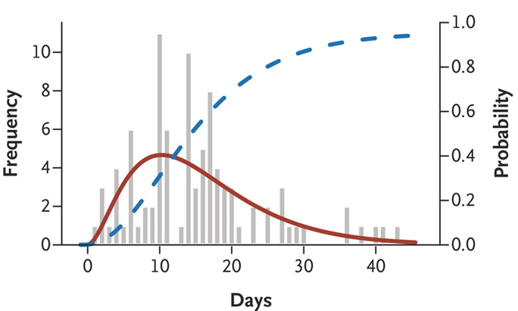
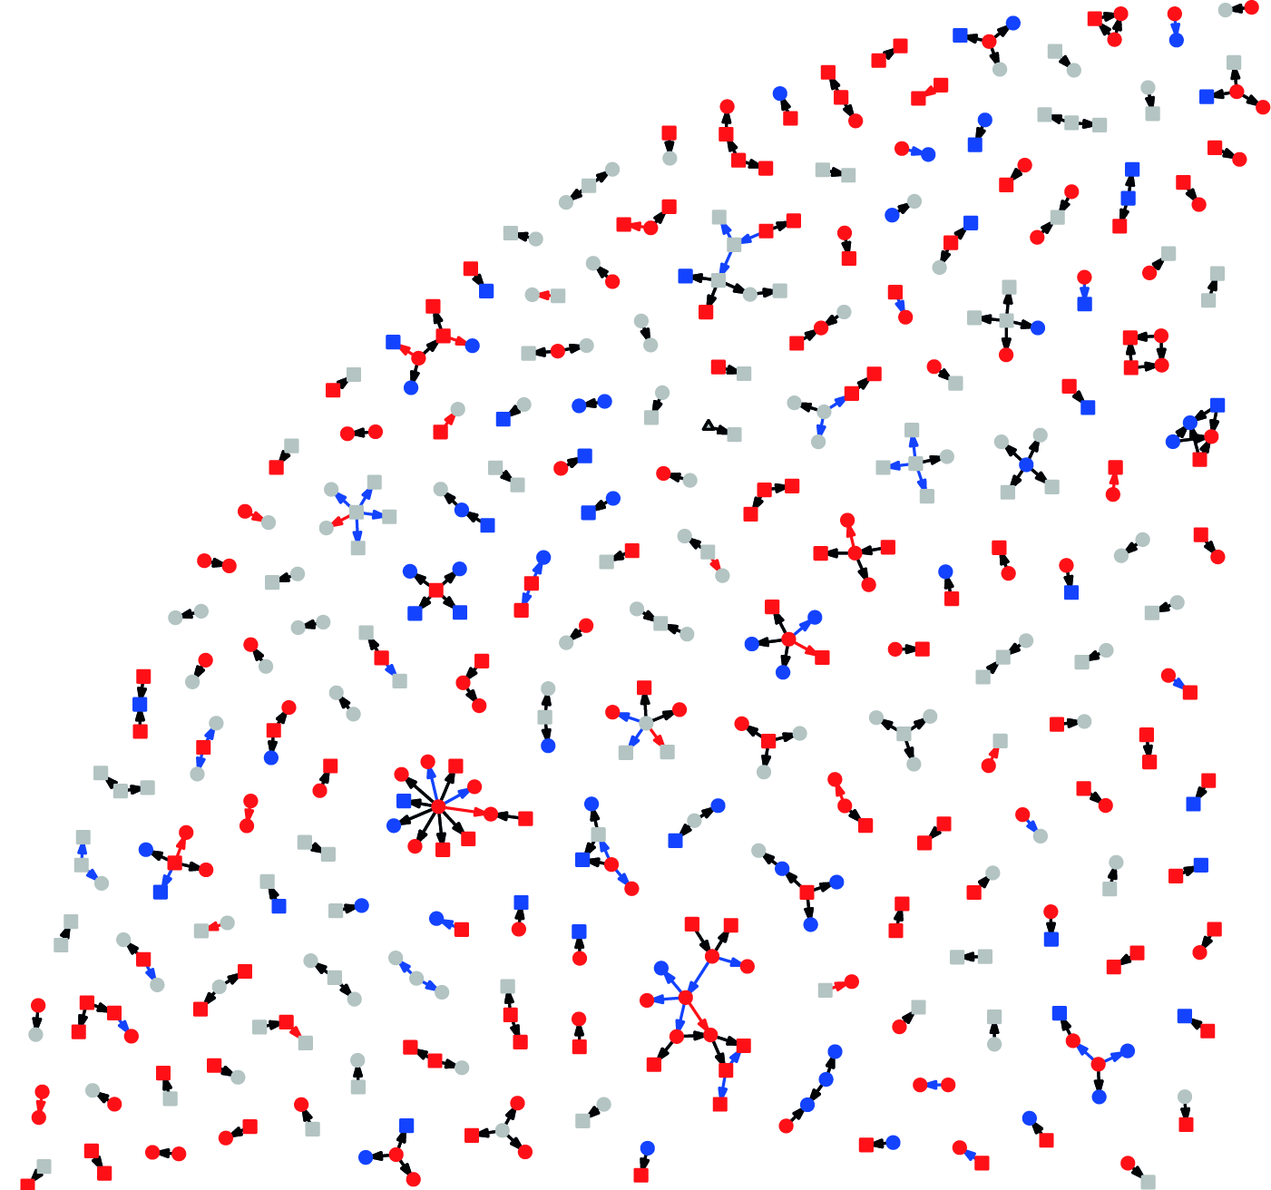
Estimating the offspring and generation time distributions
Ebola – time from onset in index to onset in
secondary case (‘serial interval’ ~ generation time)
Contact tracing (e.g. SARS, HIV, Ebola) can yield estimates of both distributions
Easier and less biased for generation time than offspring distribution
Models often make implicit assumptions about the offspring distribution (e.g. SIR)
Ebola – inferred transmission
Network from contact tracing
International/WHO Ebola Response Team NEJM 2014, PLoS Med 2016

Slide 14
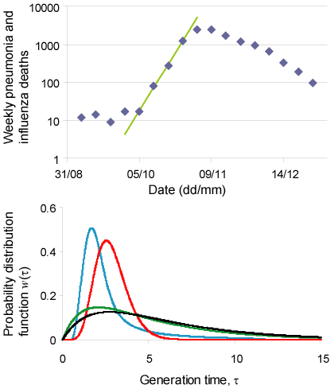
1918 influenza pandemic, London
Relationship between R0 and the early epidemic growth rate r
e.g. for constant recovery rate a
Reported estimates of the R₀ from the same data have ranged from 1.6 to 2.5 depending on generation time distribution
for further details see Grassly and Fraser 2008

Slide 15
Fundamental concepts in mathematical infectious disease epidemiology
R
Offspring distribution
Generation time distribution
contact patterns

Slide 16
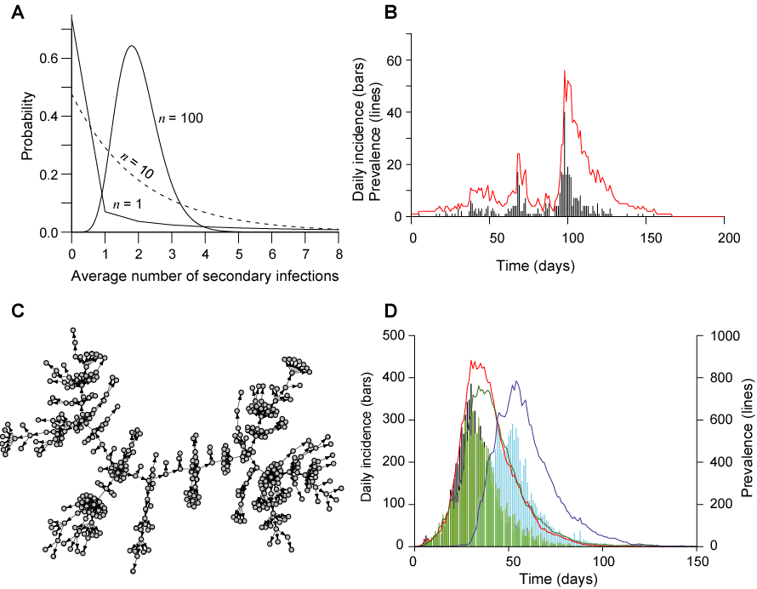
Epidemics with random mixing (1)

Slide 17
Epidemics with random mixing (2)

Slide 18
Random and non-random mixing
If individuals make contact at random with respect to the factors that determine infectiousness and susceptibility in most cases we can safely average over heterogeneity in infectiousness
Leads to commonly observed epidemic curve (once thought to be a ‘law’ by early epidemiologists)
If infectiousness and susceptibility are correlated as a result of non-random mixing then dynamics can become more complicated
Highly infectious individuals dominate early epidemic resulting in a bigger R₀ than simple average across individuals
‘Typical’ infected individual changes through the course of an epidemic and contact networks become important (e.g. HIV epidemic phases)

Slide 19
Non-random mixing
Non-random mixing is the very common: assortative mixing by age, behaviour, socio-economic group, etc…
For example, school age children made a very significant contribution to the spread of pandemic influenza in 2009
Survey of contact patterns in European countries (Mossong et al.2008)

Slide 20
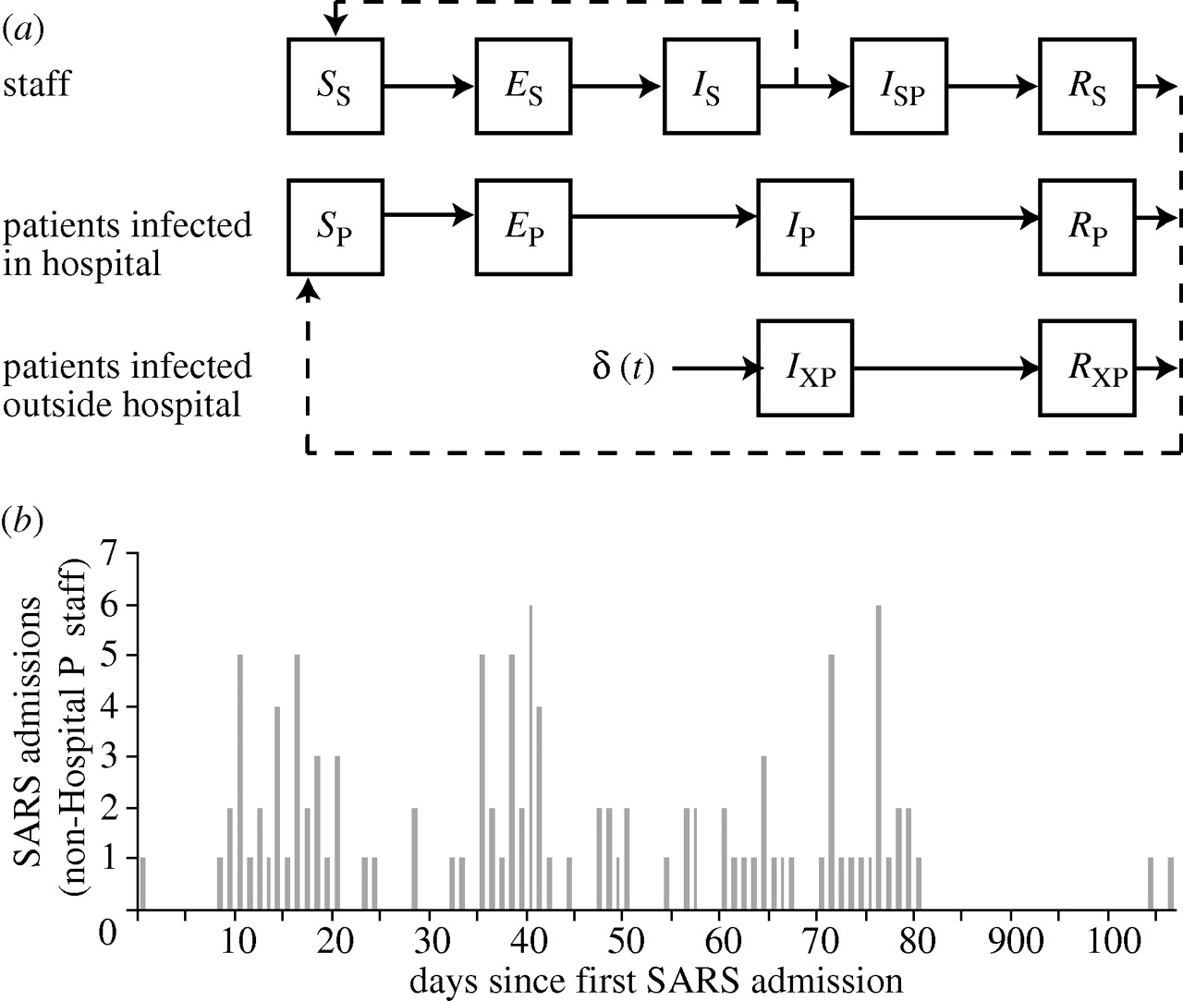
Common modelling approaches to individual heterogeneity
Compartmental models:
Compartments corresponding to homogeneous groups (e.g. age groups, social groups, geographic location, )
ordinary differential equations (ODEs)
stochastic differential equations (typically solved numerically using Monte Carlo simulation)
Individual (‘agent’)-based models:
status or history-based approaches
Kwok et al. 2007
Nurhonen et al. 2013

Slide 21
Modelling approaches to mixing patterns
Who acquires infection from whom (WAIFW) matrix
Spatial models
Network models

Slide 22
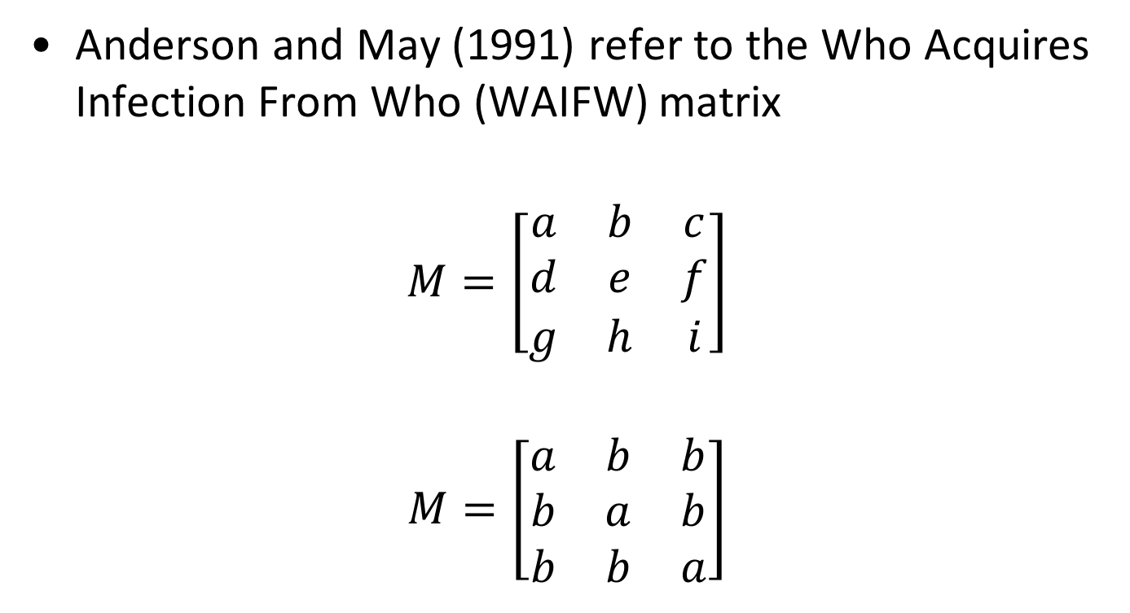
Who infects who?
Anderson and May (1991) refer to the Who Acquires Infection From Who (WAIFW) matrix
$$M=\left[\begin{matrix}a & b & c \\ d & e & f \\ g & h & i\end{matrix}\right]$$
$$M=\left[\begin{matrix}a & b & b \\ b & a & b \\ b & b & a\end{matrix}\right]$$
simplify

Slide 23
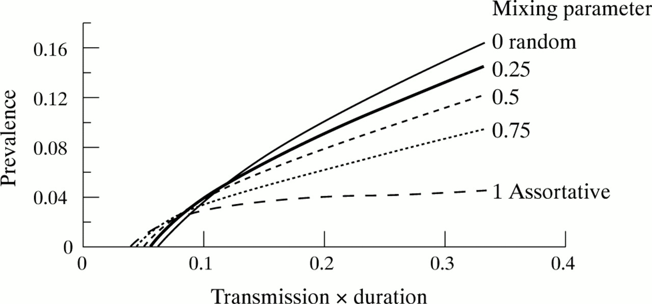
Compartmental ODE model with a mixing matrix
G P Garnett Sex Transm Infect 2002;78:7-12

Slide 24
Spatial transmission models
Riley 2007 Science 316:1298-1301

Slide 25
Network models
vertex (pl. vertices)
edge
Networks and the associated theory may be used to represent contact patterns
Network ‘vertices’ (or ‘nodes’) may be individuals (e.g. sexual networks) or groups of individuals (e.g. metapopulation models)
Network ‘edges’ represent patterns of contact between individuals or populations
Structure may be inferred from data on contact patterns using different techniques

Slide 26
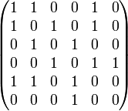
Network statistics (1)
Networks consist simply of set of N vertices and M edges
Possible number of edges = N(N-1)/2 and considered sparse if M<<N(N-1)/2
Adjacency matrix M – N x N matrix, with elements number of edges joining i and j e.g. (c.f. WAIFW matrix)
vertex (pl. vertices)
edge

Slide 27
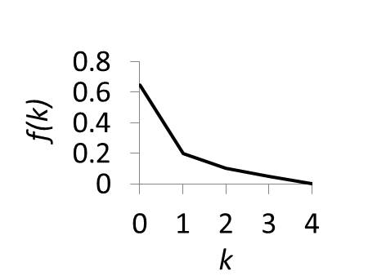
Network statistics (2)
Degree k_{v} – number of edges joined to vertex v, average <k>, degree distribution f(k). This determines the number of secondary infections per vertex (e.g. individual).
Average (or characteristic) path length L is the average number of edges along the shortest paths for all possible pairs of network vertices. This determines how quickly disease can spread on the network.
Local clustering coefficient C_{v} extent to which vertices in neighbourhood about v are adjacent to each other (total number of edges about v/total number of possible edges). This determines local saturation effects that limit the epidemic (i.e. contact is already infected).
C_{v} = 2/3
C_{v} = 0/3

Slide 28
Types of network
All individuals
have same degree
Random connections
Degree distribution
follows power law
Mostly local, some
long distance
Leventhal et al. 2014

Slide 29
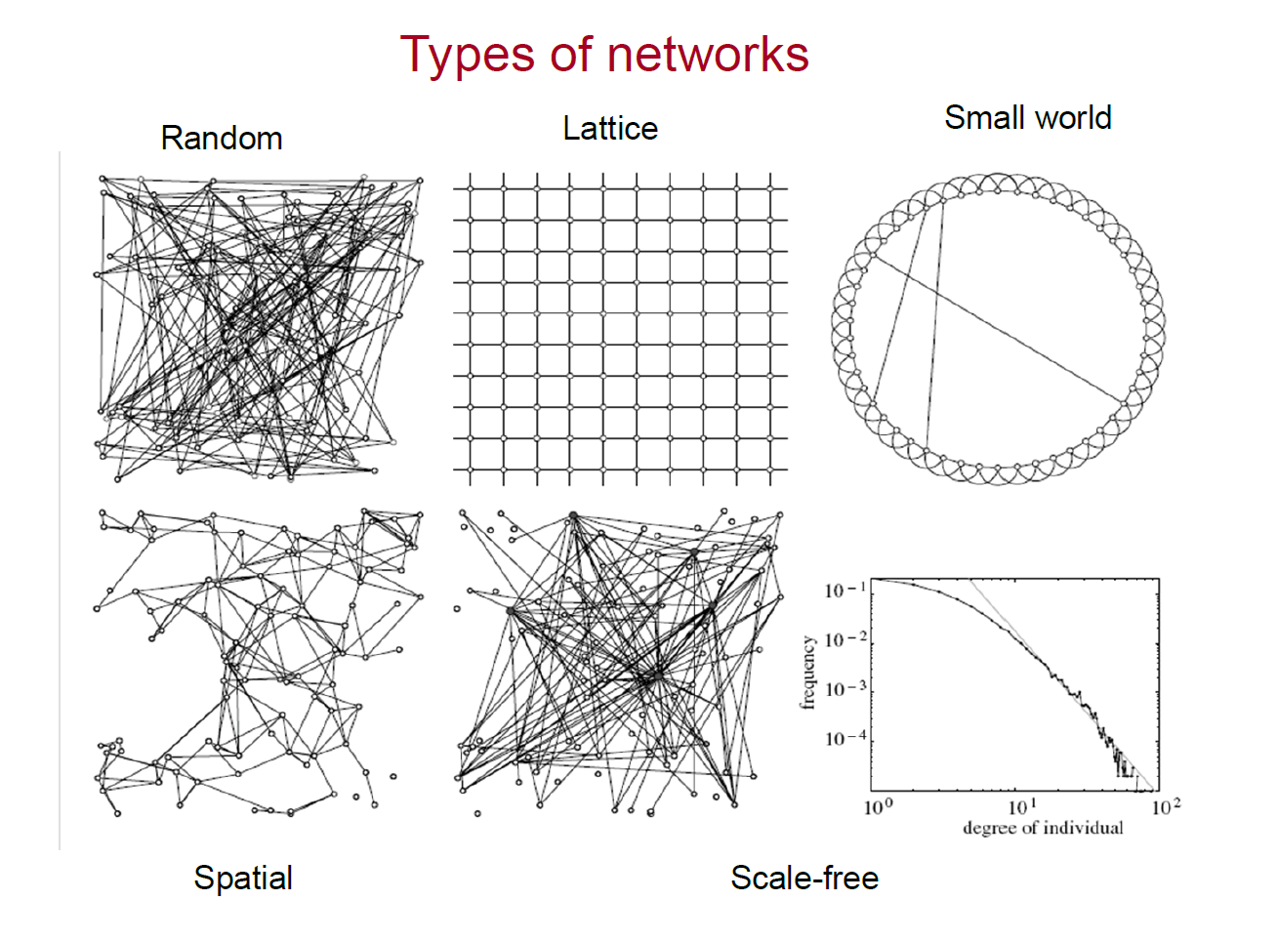
Transmission on a network
Consider a simple SIR epidemic spreading on a network.
The basic reproductive number
where cv is the coefficient of variation for the degree distribution f(k)
(standard deviation divided by the mean) and the mean.
cv = 0.137
cv = 15.3

Slide 30
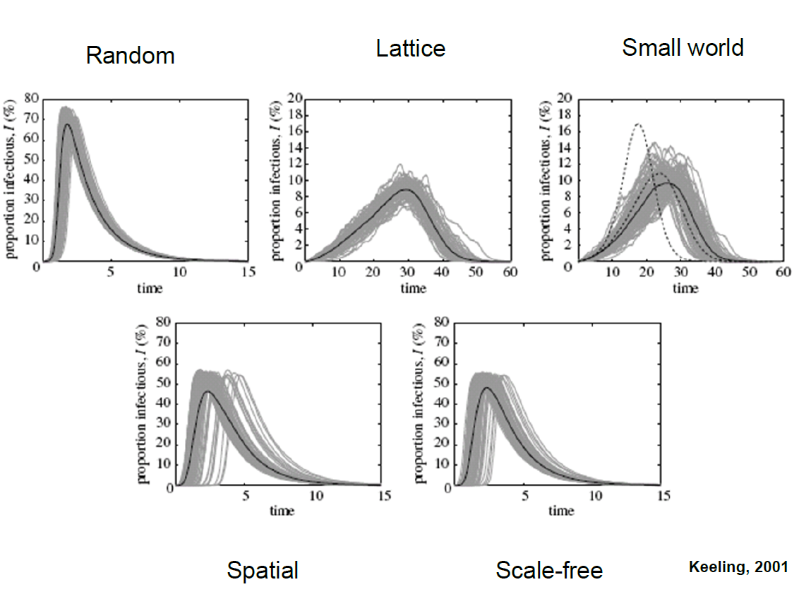
Typical SIR model epidemics on different types of network
Theoretical networks
Keeling 2001, Leventhal et al. 2014

Slide 31
Further reading
Grassly NC & Fraser C. Mathematical models of infectious disease transmission. Nat Rev Microbiol 2008; 6: 477-87.
Vynnycky E and White RG An Introduction to Infectious Disease Modelling. 2010. Chapter 7 How do models deal with contact patterns?

Slide 32
Types of network
P(k) ~ k^{-γ}

